Slide 1

Vector analysis
GEO3460 – Geografiske informasjonssystemer (GIS) og geografisk datainnsamling – vår 2025
GEO3460 - Geographical Information Systems (GIS) and Geographical Data Acquisition - spring 2025
Luc Girod (luc.girod@geo.uio.no)
Based on the lectures by Livia Piermattei and Martin Lund

Slide 2
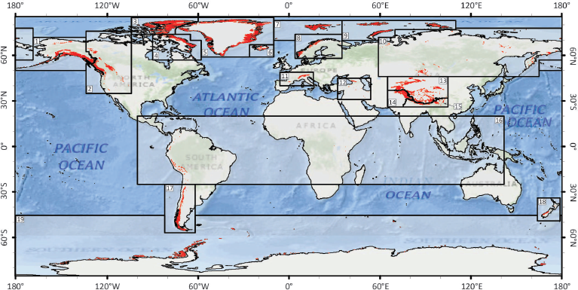
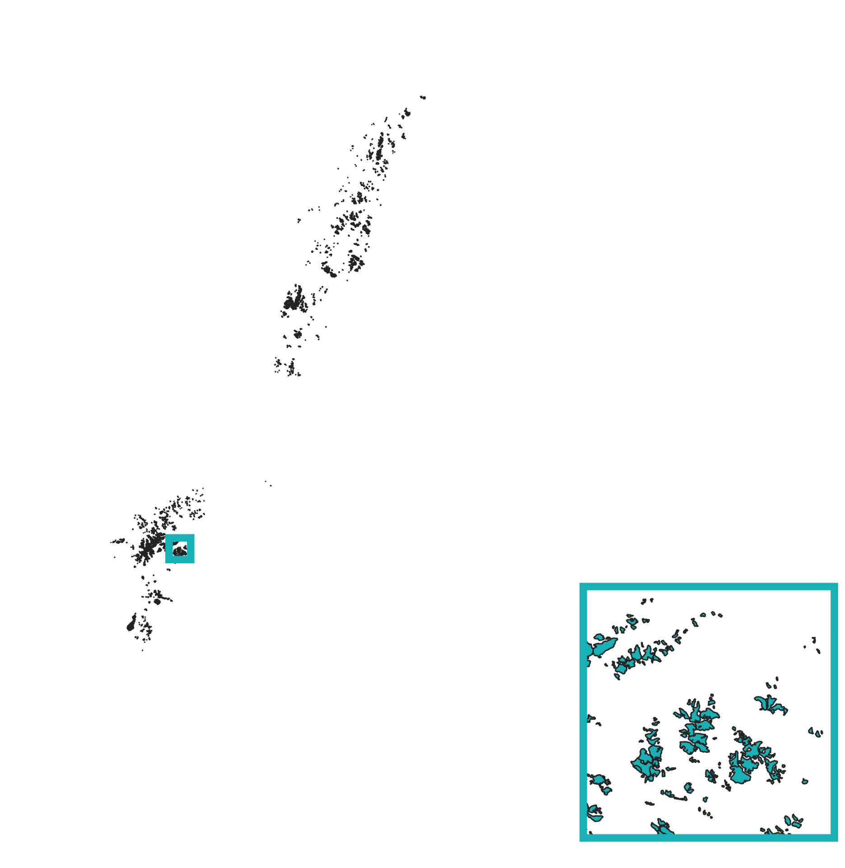
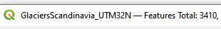
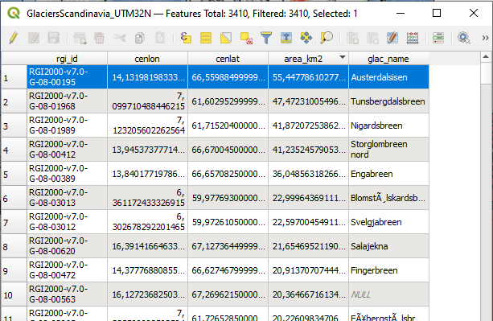
A simple example
Randolph Glacier Inventory vector file
→Geography question?
Where are glaciers in Fennoscnadia?
How many are there??
In which area are the biggest ones?

Slide 3
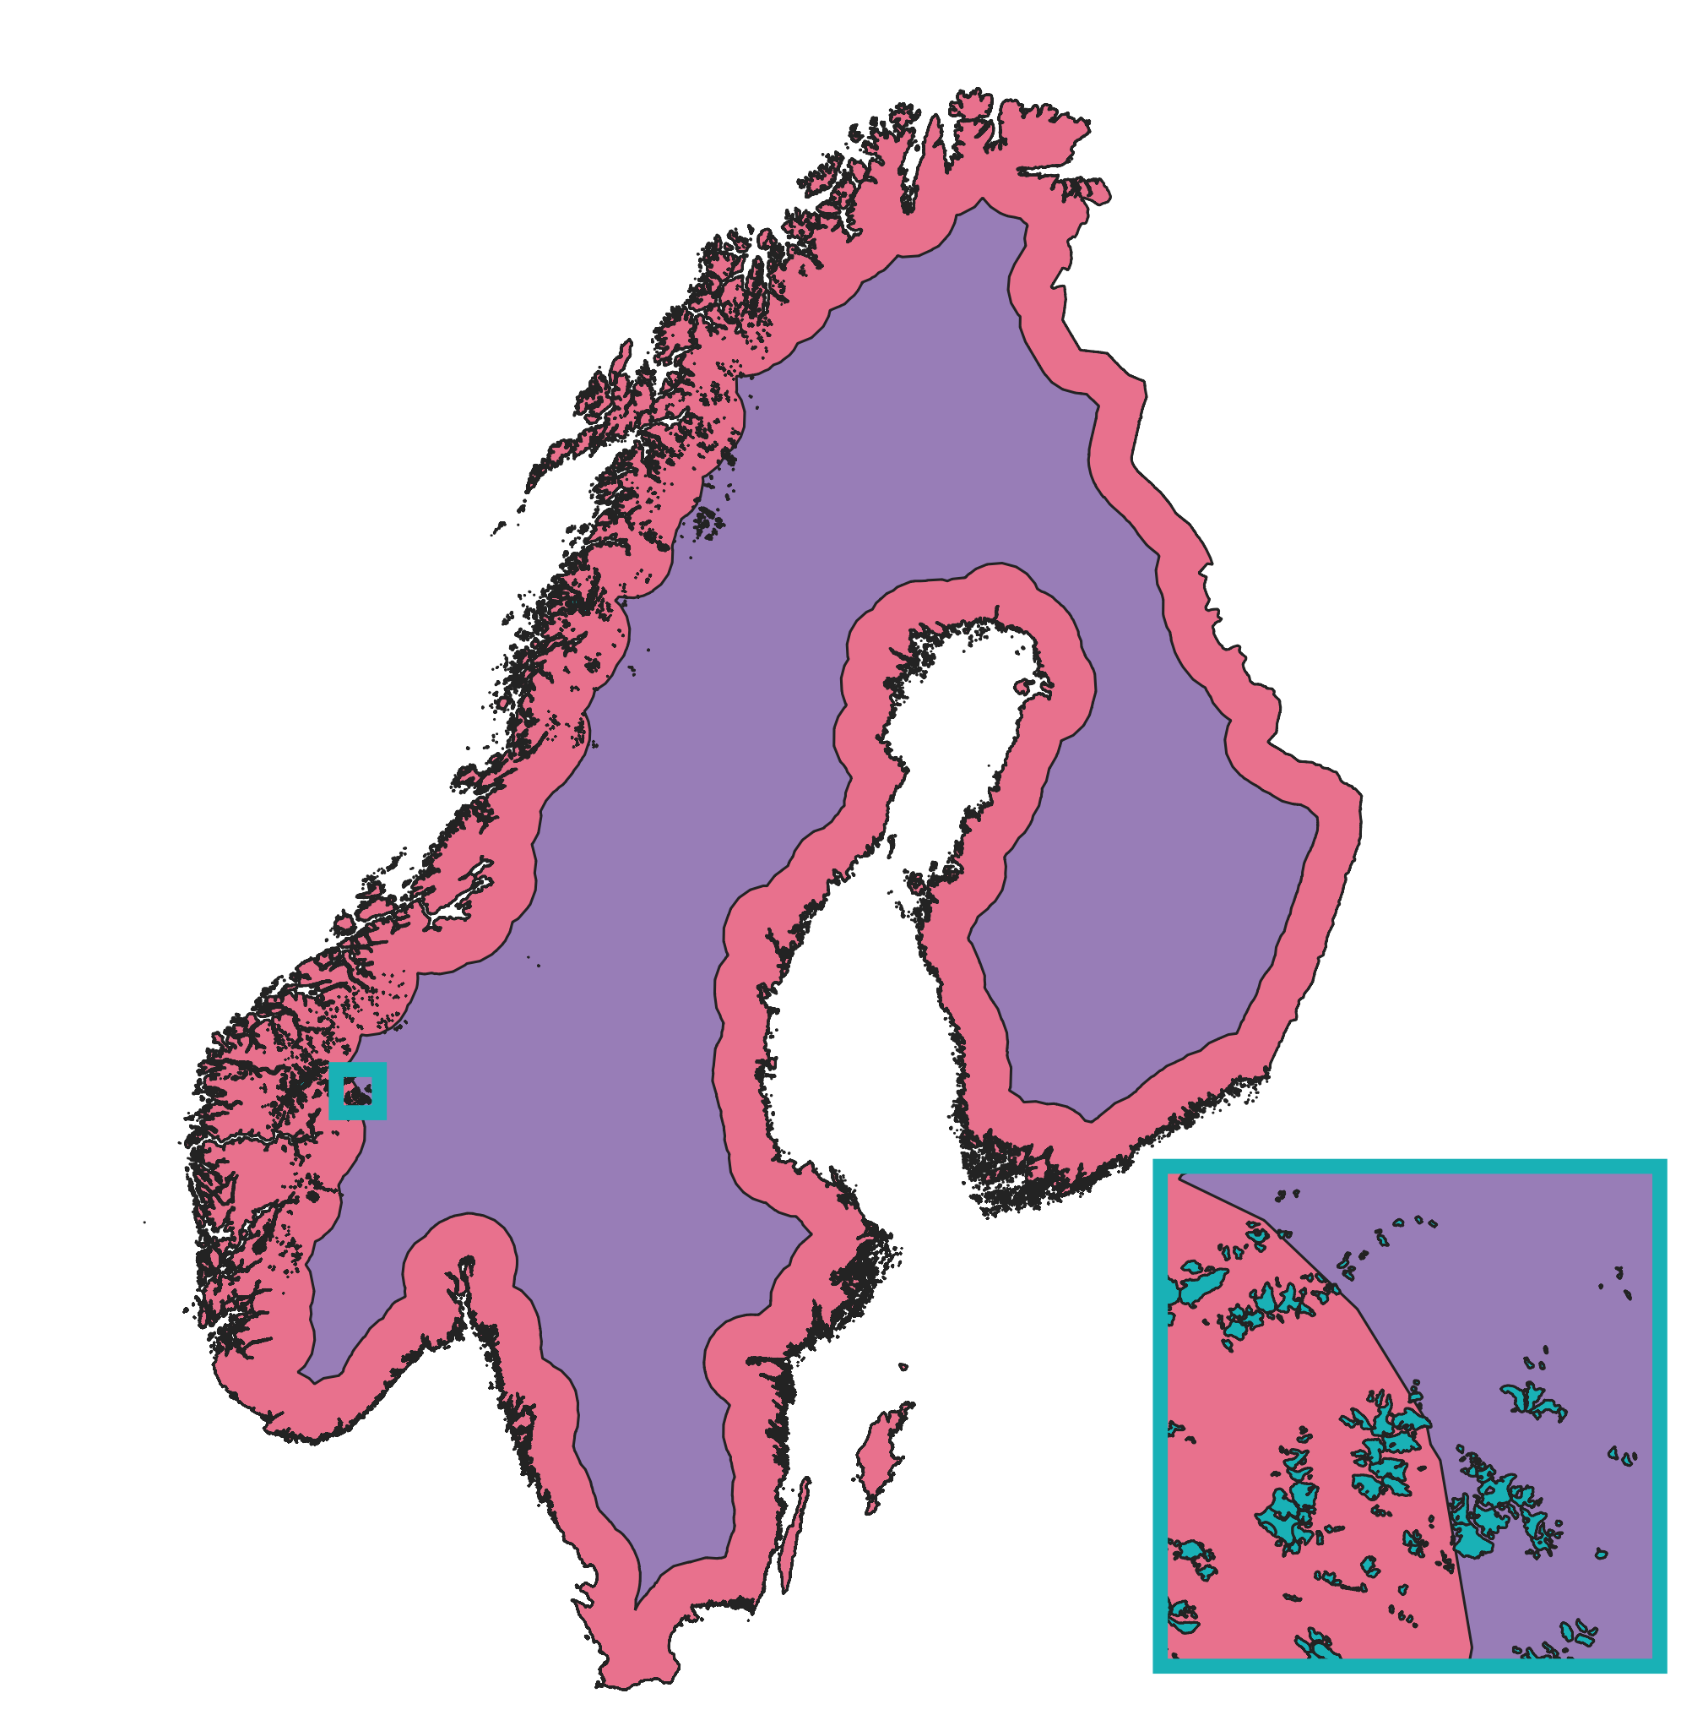
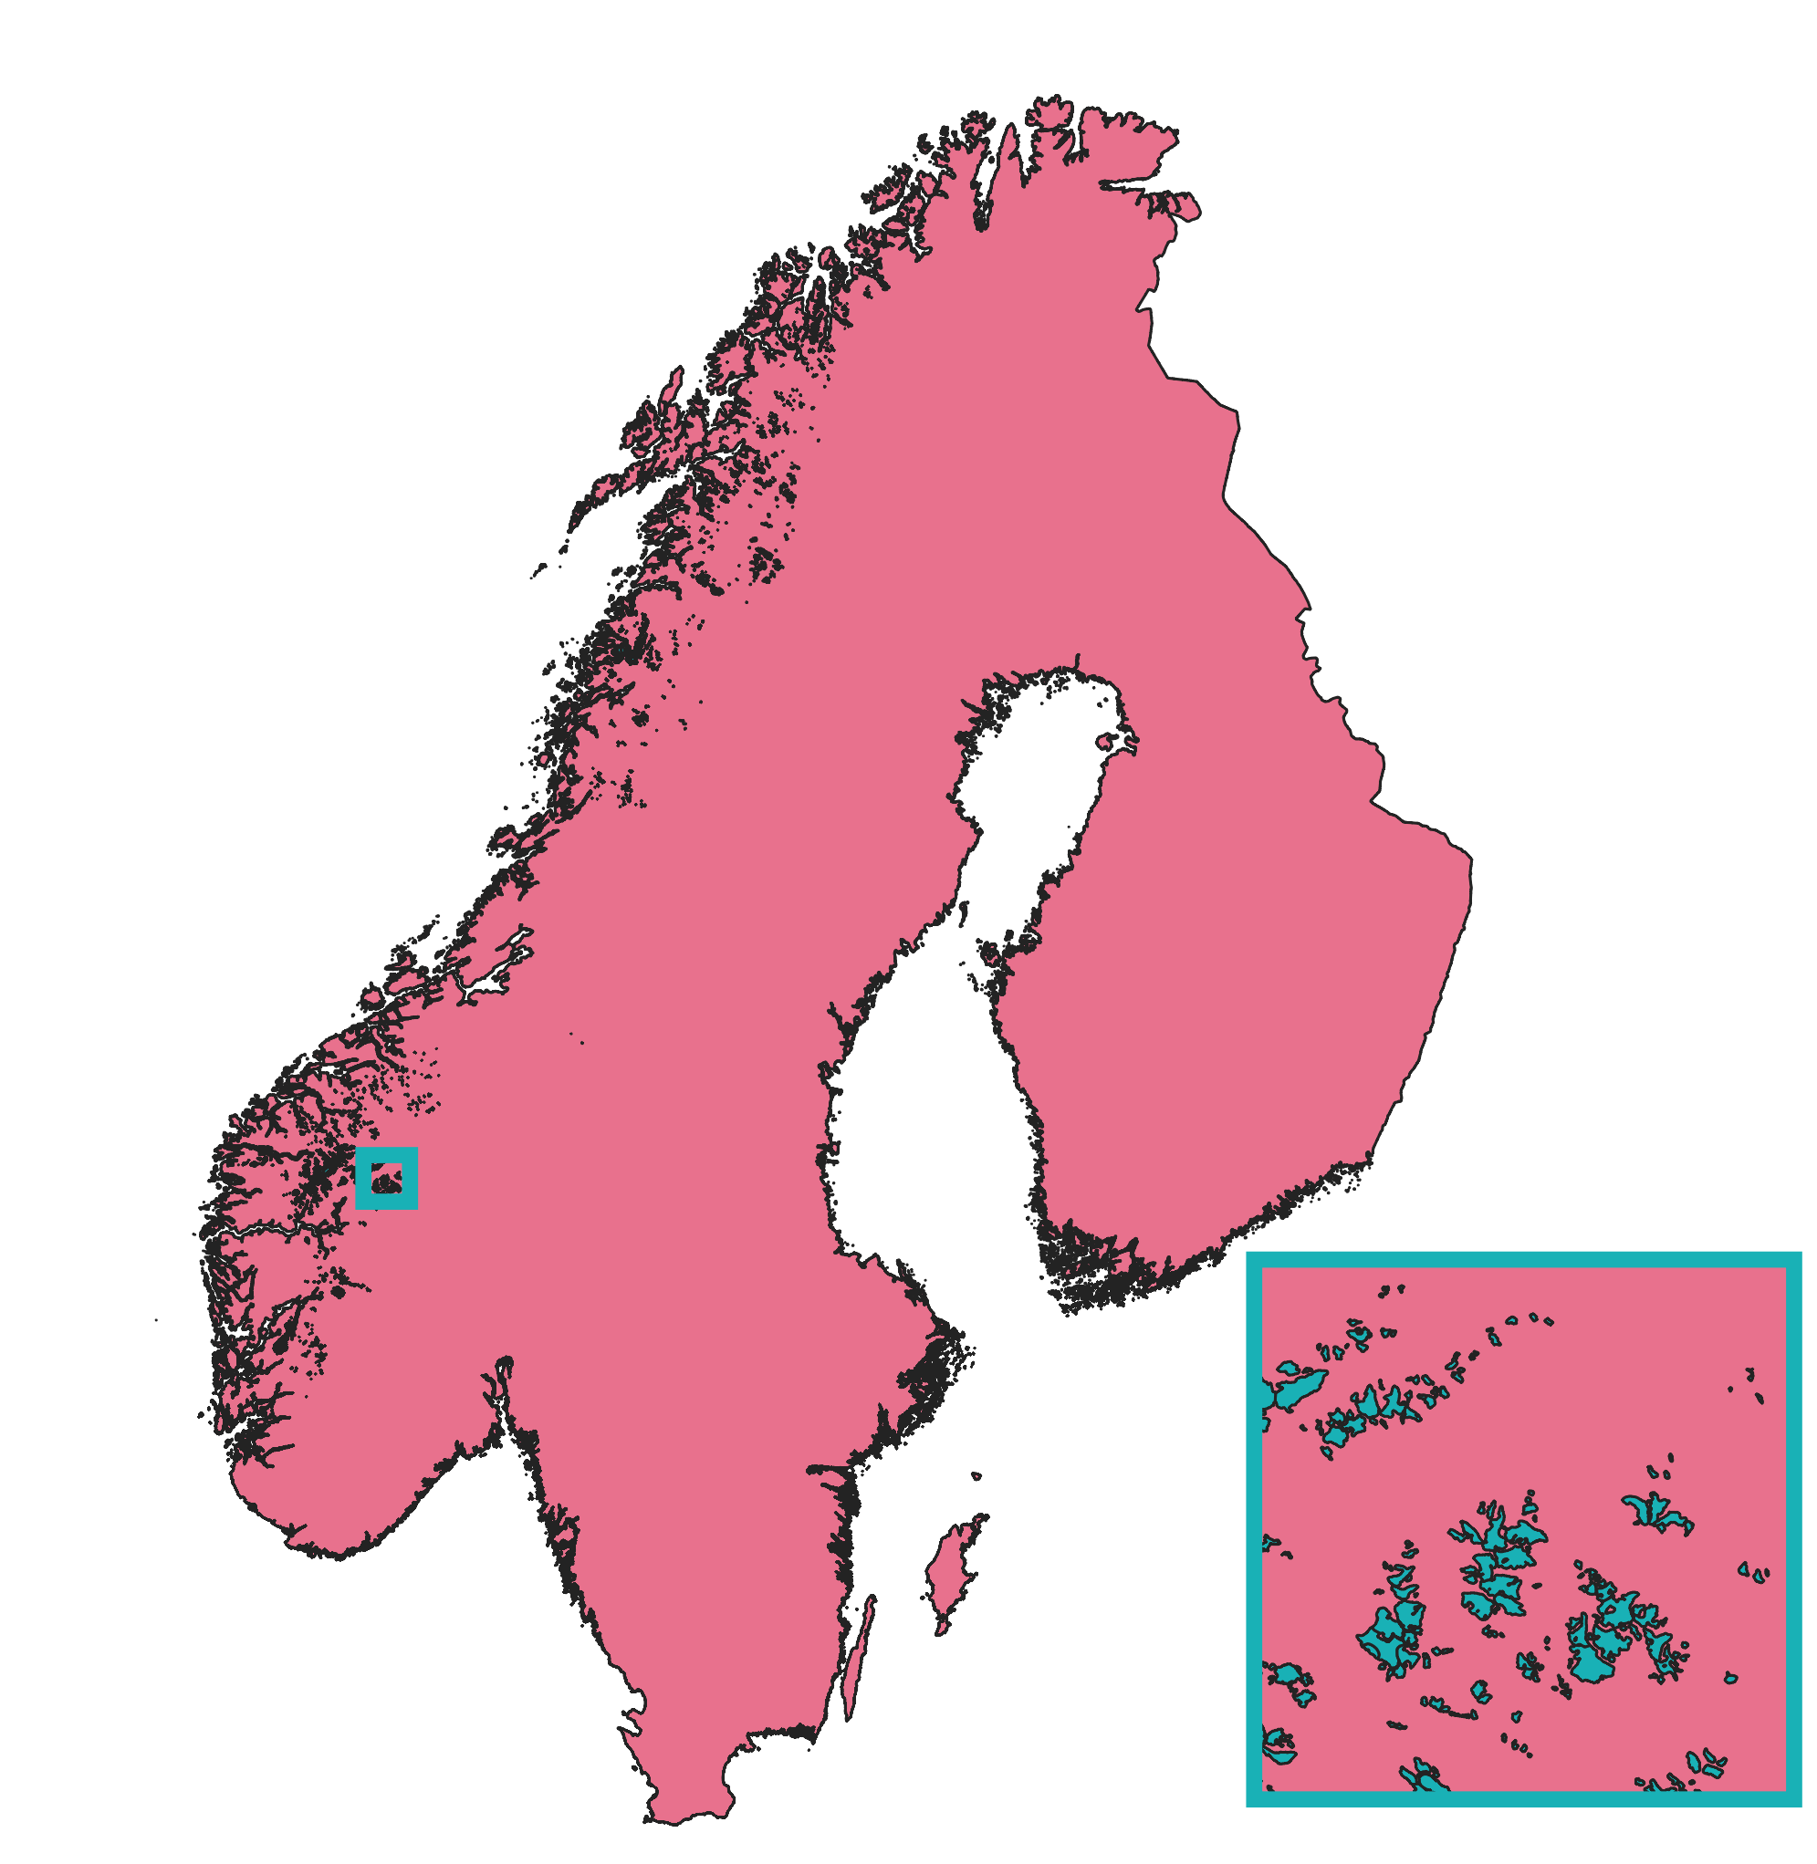

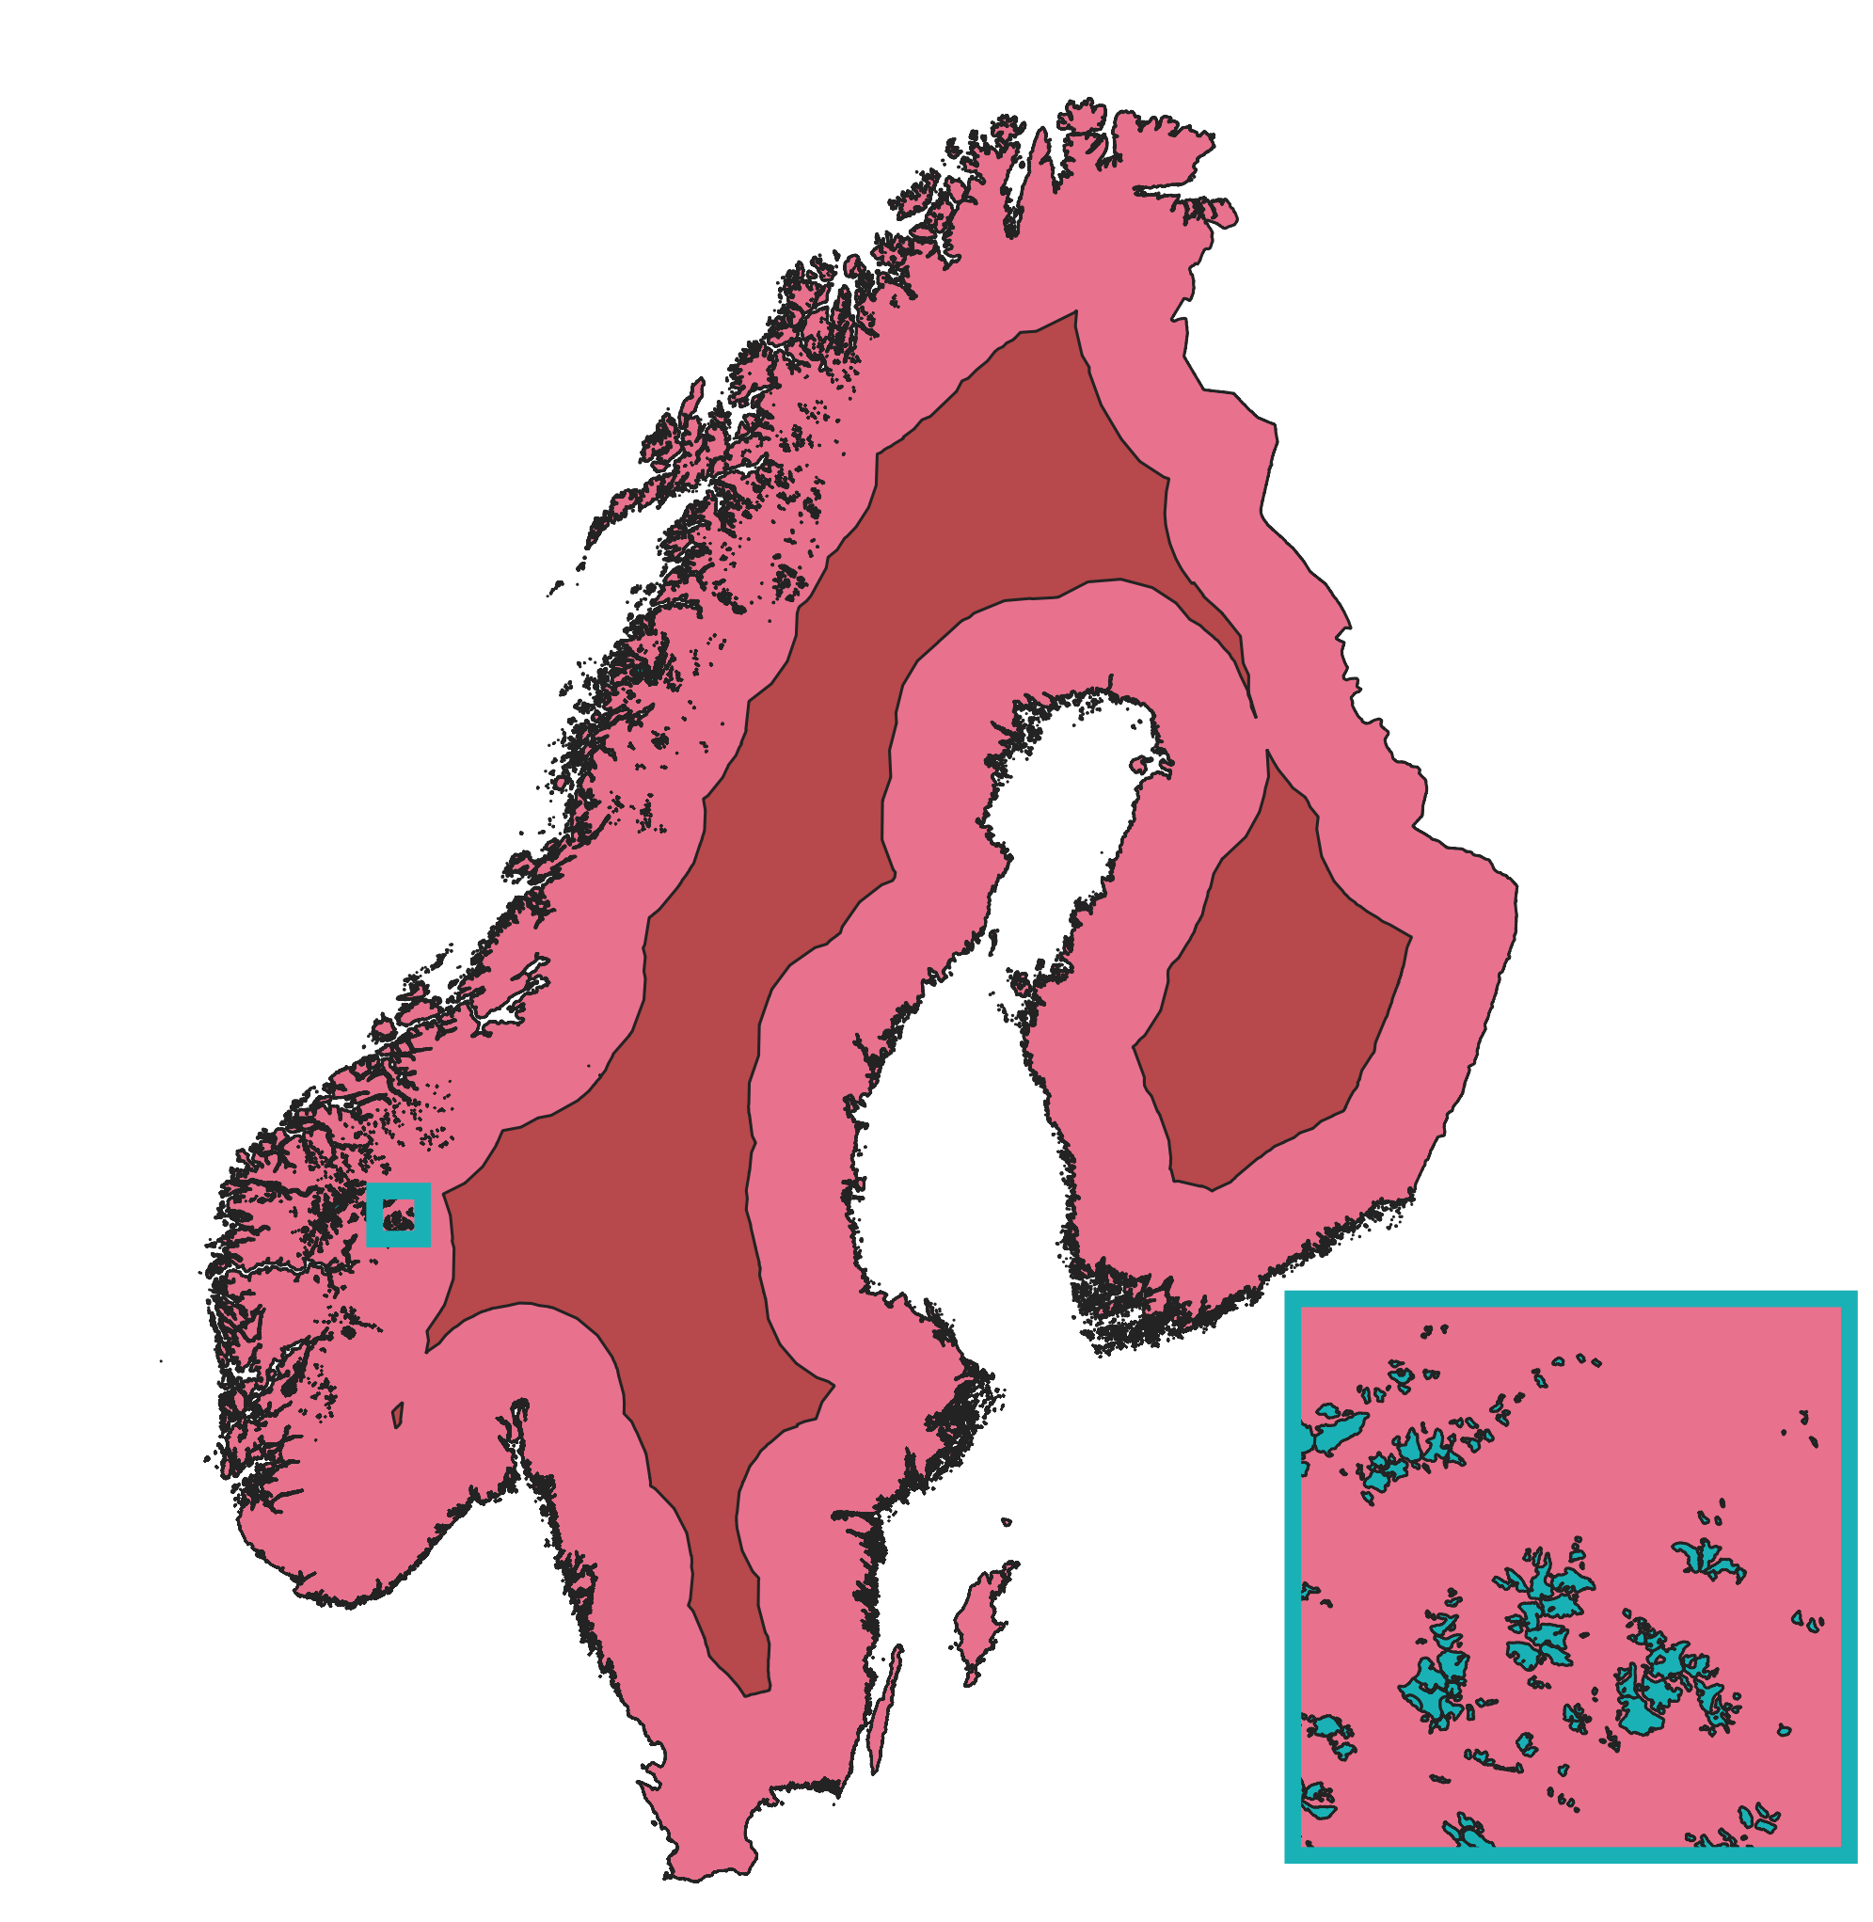
A simple example
Spatial analysis
Are there glaciers >50km from the coast?
Are there glaciers >100km from the coast?

Slide 4

Reference text book:
“Geographical information systems”
Chapter 7

Slide 5

Learning Objectives
1
2
3
Conversion between data models
Rasterization
Vectorization
Geometric operation
(vector)
Distance
Buffer
…
Attribute operations
(vector & raster)
Selection by attribute and location
Aggregation
Overlay
Today’s topics
Notes:
Start with some repetition from the last lecture.

Slide 6
Learning Objectives
1
2
3
Conversion between data models
Rasterization
Vectorization
Geometric operation
(vector)
Distance
Buffer
…
Attribute operations
(vector & raster)
Selection by attribute and location
Aggregation
Overlay
Today’s topics

Slide 7
Conversion Between Data Models
Recall the difference between raster and vector data…
1. Vector Data Model
Shapefiles (.shp): point, lines, polygons
2. Raster Data Model
. tiff, .img., .asc
Some key differences between the two data models
Composed of points (or nodes) that have exact location in space
Points can be singular or can be connected to form polylines or polygons
Vector data uses sets of coordinates and associated attribute data to define discrete objects
Vectors will not distort or pixelate, no matter how far we are zoomed in
Composed of cells (or pixels) that have a constant resolution
Raster can be
discrete (e.g. land cover where raster are categorical e.g. urban area = 1 and forest = 2)
Continuous: grid cells with gradual changing values e.g. elevation, temperature and remote sensing image
Because cell size are constant rasters will become pixelated when zoomed-in to very close range
Notes:
Very often doing geospatial analysis we need to convert between the two data models, raster and vector.
Let see some key differences between the two data models
We already saw that Vector data are composed of points, polylines, and polygons. Unlike vector data, rasters are made up of pixels or grid cells.
http://gsp.humboldt.edu/OLM_2017/Lessons/GIS/08%20Rasters/RasterToVector.html
https://gisgeography.com/rasterization-vectorization/#:~:text=Double%2Dclick%20the%20tool%20and,in%20the%20table%20of%20contents.

Slide 8
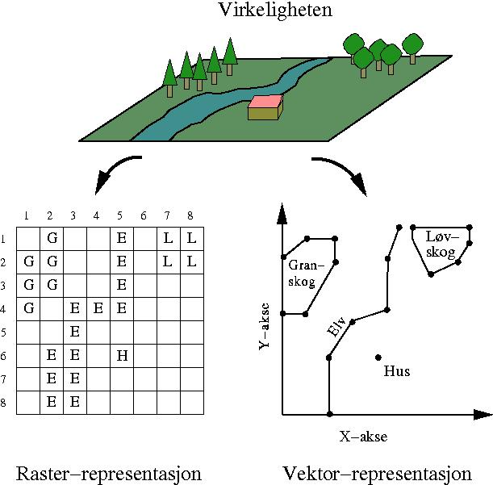
Conversion Between Data Models
You can convert data between raster and vectors but the nature of the data will be very different
Rasterization converts vectors into rasters
Vectorization transforms rasters into vectors
…and how we can convert between these data models (hint: pushing buttons in ArcGIS)
…and what is actually happening behind the scenes to make this possible
Notes:
we’ll talk about why you might want to convert between these two data models
Rasterization converts vectors into rasters. But vectorization transforms rasters in vectors.
We know the two main data models and graphics are vector and raster data.
But how do you go from one data model to the other?
That is when you would use rasterization and vectorization.

Slide 9
Conversion Between Data Models
You can convert data between raster and vectors but the nature of the data will be very different
Why? The data model we have is not always the data model we want
Rasterization converts vectors into rasters
Vectorization transforms rasters in vectors
…and how we can convert between these data models (hint: pushing buttons in ArcMap)
…and what is actually happening behind the scenes to make this possible

Slide 10
Conversion Between Data Models
Rasterization (convert Vector to Raster)
Notes:
Any feature class (geodatabase, shapefile, or coverage) containing point or multipoint features can be converted to a raster dataset.

Slide 11
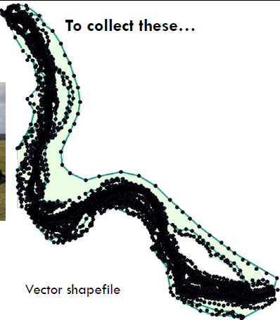
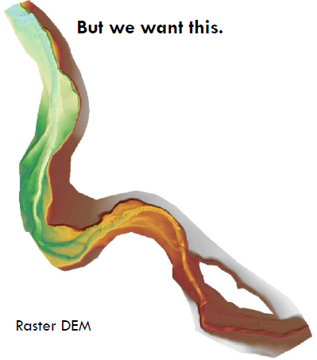
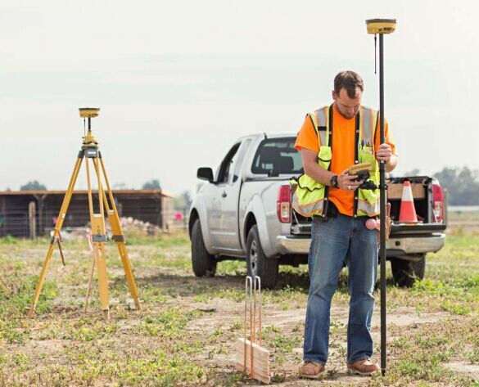
Conversion Between Data Models
Rasterization (convert Vector to Raster): Point to Raster
the most common data model conversion that you will encounter
Example: to collect elevation information
we use this (GPS)…
Alex Walker, USU
Notes:
Any feature class (geodatabase, shapefile, or coverage) containing point or multipoint features can be converted to a raster dataset.

Slide 12
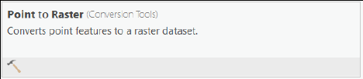
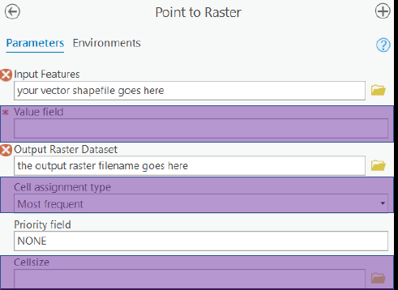
Conversion Between Data Models
Rasterization (convert Vector to Raster): Point to Raster
the most common data model conversion that you will encounter
Point to Raster conversion tool in ArcPro
The attribute field of the input points
Cell assignment method
cell size (or resolution) of the output raster
How do you choose the cell size?
https://pro.arcgis.com/en/pro-app/latest/tool-reference/conversion/point-to-raster.htm
Notes:
To make a DEM, what would the value field be? Elevation
Your raster resolution is only as good as your point density. Remember Raster resolution is a tradeoff between the information you want to convey and the size (and processing time) of the file you’re dealing with.
To DOUBLEthe resolution, we have to QUADRUPLE the cells So be very careful, because files can get really big, really fast.

Slide 13
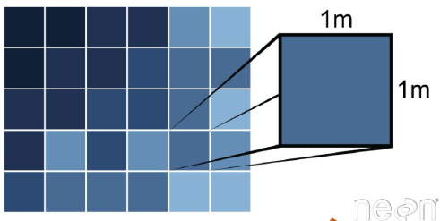
Conversion Between Data Models
Rasterization (convert Vector to Raster): Point to Raster
the most common data model conversion that you will encounter
Raster consideration: Resolution
Remember: raster resolution is a tradeoff between the information you want to convey and the size (and processing time) of the file you are dealing with.
“1 m resolution”
“0.5 m resolution”
1 m
1 m
1 m
1 m
To DOUBLE the resolution, we have to QUADRUPLE the cells. So be very careful, because files can get really big.
Notes:
To make a DEM, what would the value field be? Elevation
Your raster resolution is only as good as your point density. Remember Raster resolution is a tradeoff between the information you want to convey and the size (and processing time) of the file you’re dealing with.
To DOUBLEthe resolution, we have to QUADRUPLE the cells So be very careful, because files can get really big, really fast.

Slide 14
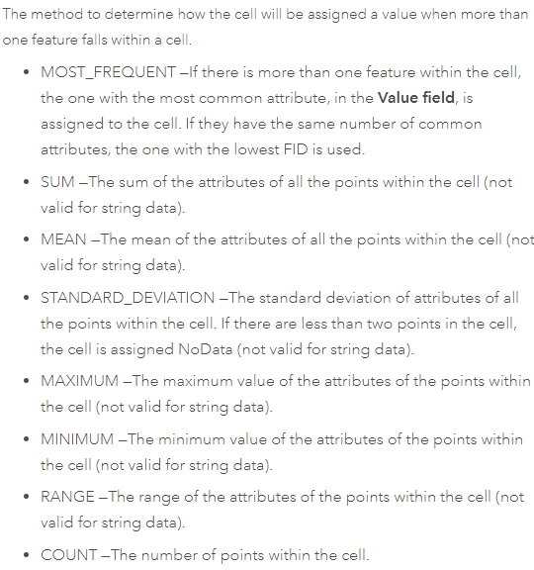
Conversion Between Data Models
Rasterization (convert Vector to Raster): Point to Raster
the most common data model conversion that you will encounter
Examples using different options for the cell assignment method in ArcMap
when more than one feature falls within a cell, which method do you use to assign a value to the cell?

Slide 15
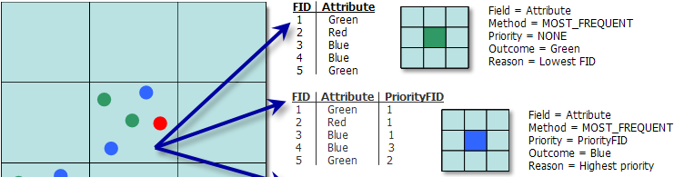
Conversion Between Data Models
Rasterization (convert Vector to Raster): Point to Raster
the most common data model conversion that you will encounter
Examples using different options for the cell assignment method in ArcMap
https://pro.arcgis.com/en/pro-app/latest/tool-reference/conversion/point-to-raster.htm
Notes:
A FID in ArcMap is a system-managed value that uniquely identifies a record or feature
FID stands for Fundamentals of ObjectID and the value starts with 0

Slide 16
Conversion Between Data Models
Rasterization (convert Vector to Raster): Point to Raster
the most common data model conversion that you will encounter
Examples using different options for the cell assignment method
Common methods:
Most frequent:
categorical data (land cover type)
Mean:
continuous data (elevation, temp, precipitation)
Notes:
Nominal vs Ratio attributes

Slide 17
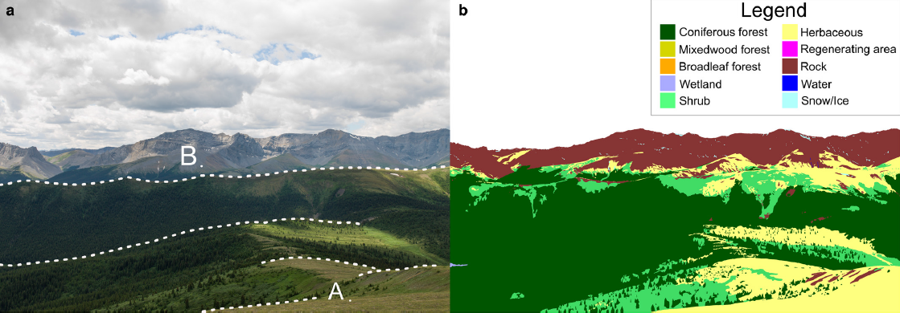
Conversion Between Data Models
Rasterization (convert Vector to Raster): Polygon to Raster
Why we might want to do this?
because doing geometry calculations on vector data is slow over big areas
because we often want to compute changes from one attribute to another
Polygon representation of land cover
Source: Fortin et al., 2018

Slide 18
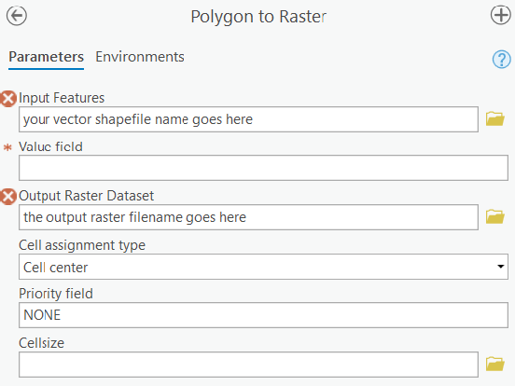
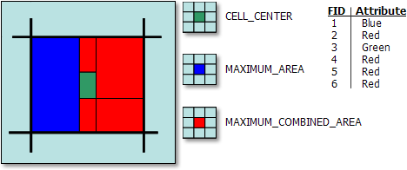
Conversion Between Data Models
Rasterization (convert Vector to Raster): Polygon to Raster
Why we might want to do this?
because doing geometry calculations on vector data is slow over big areas
because we often want to compute changes from one attribute to another
The attribute field of the input polygon that you want your raster to represent
Cell assignment method. What happens if there’s more than one polygon in the resulting raster cell?!
https://pro.arcgis.com/en/pro-app/latest/tool-reference/conversion/polygon-to-raster
cell size (or resolution)
do we want the output raster
Illustration of six polygons that fall within a single cell

Slide 19
Conversion Between Data Models
Vectorization (convert Raster to Vector)

Slide 20
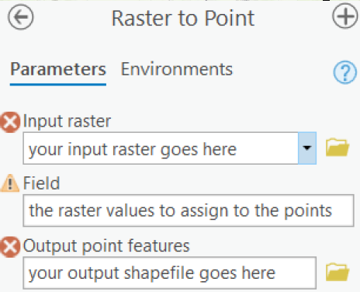
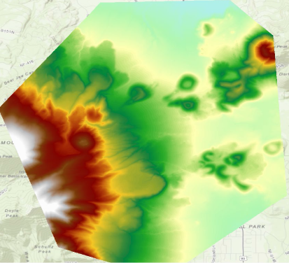

Conversion Between Data Models
Vectorization (convert Raster to Vector): Raster to Point
Use:
For displaying values differently
Further post-processing of point data: e.g. elevation data convert to point
Raster to Point conversion tool in ArcPro will get you there but it can be really slow on big rasters.
By Alan Kasprak
Notes:
Need vector data for topology.

Slide 21
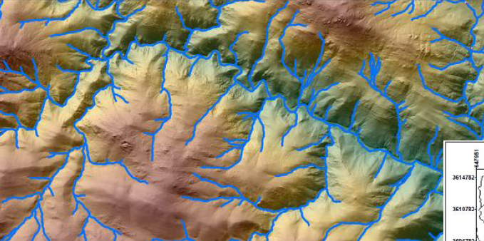
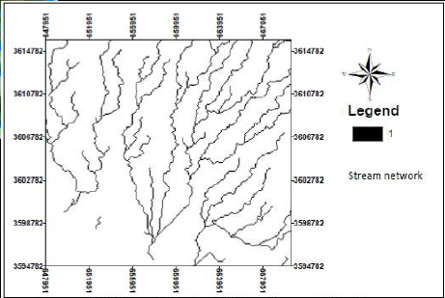
Conversion Between Data Models
Vectorization (convert Raster to Vector): Raster to Polyline
Use:
Often used in hydrologic modeling
Used in image classification (how can we compute the length of roads)
Things that are inherently linear (e.g., streams, road)
By Alan Kasprak
Notes:
Need vector data for topology.

Slide 22
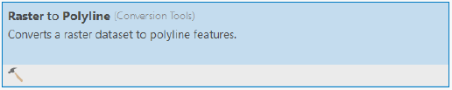
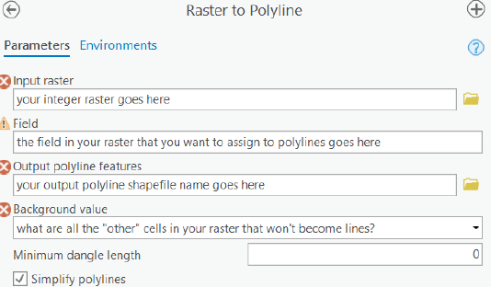
Conversion Between Data Models
Vectorization (convert Raster to Vector): Raster to Polyline
Use:
Often used in hydrologic modeling
Used in image classification (how can we compute the length of roads)
Note: Input raster needs to be an “integer” type
The polylines are smoothed and do not follow the square edge of the raster
Notes:
Why does it have to be integer data? DISCUSS

Slide 23
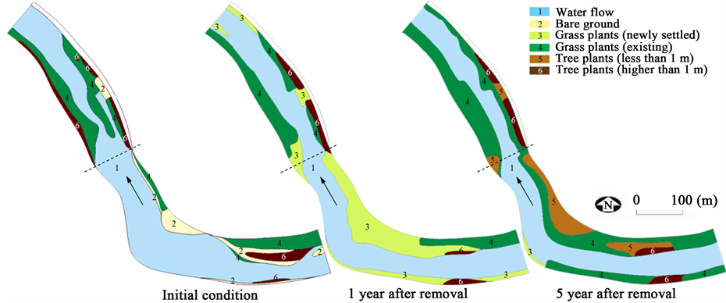
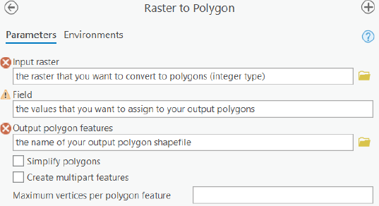
Conversion Between Data Models
Vectorization (convert Raster to Vector): Raster to Polygon
Use:
Nicely displaying features on a map (remember raster are pixel!)
Computing the distance between features
Computing the area of groups of features (e.g., different types of forest)
Quantify changes!
Example: Effects of a Low-Head Dam Removal on River Morphology and Riparian Vegetation. Kim et al., 2014

Slide 24
Conversion Between Data Models
Raster to Raster Conversion
To change formats and cell sizes/resolutions…
Why?
Example: you have two rasters
One at high resolution
Another one at low resolution
For comparison and more accurate analysis the two rasters should have the same resolution:
→ resample the finer resolution raster to the same resolution of the coarser ones
Notes:
DISCUSSION for the students: Which should be resampled to which?

Slide 25
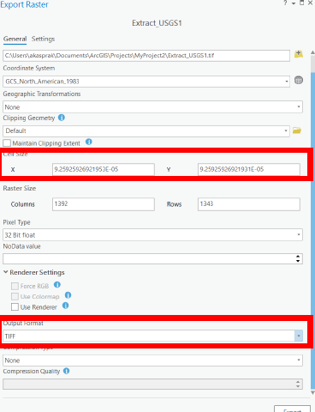
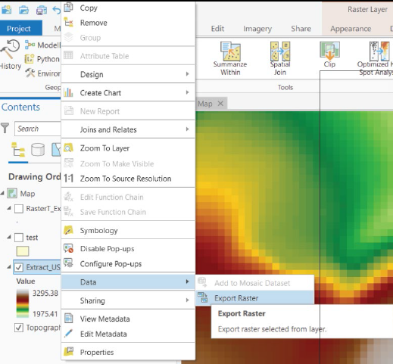
Conversion Between Data Models
Raster to Raster Conversion
To change formats and cell sizes/resolutions…
Tool Export raster (the quickest way)
Making all the raster datasets the same resolution

Slide 26
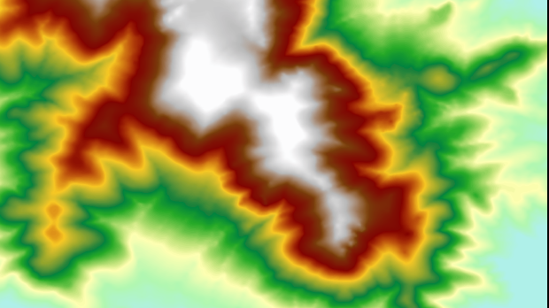
Conversion Between Data Models
Raster to Raster Conversion
To change cell sizes/resolutions: Tool Resample
From 10 m resolution…
What do you see here?
Notes:
What do you see here?

Slide 27
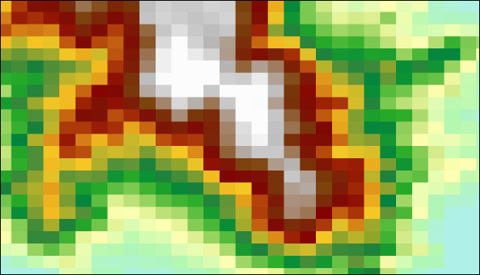
Conversion Between Data Models
Raster to Raster Conversion
To change cell sizes/resolutions: Tool Resample
From 10 m resolution…
What happened when I altering the resolution of the raster?
Raster of an area at a fine resolution
…to 200 m
resolution
Raster of an area at a coarse resolution

Slide 28
Conversion Between Data Models
Raster to Raster Conversion
To change cell sizes/resolutions: Tool Resample
From 10 m resolution…
Different choices for resampling the raster:
Nearest Neighbor → best for discrete data
Bilinear → best continuous data (elevation, slope, temperature, precip.)
Cubic Convolution
Majority
…to 200 m
resolution
Notes:
What do you see here?

Slide 29
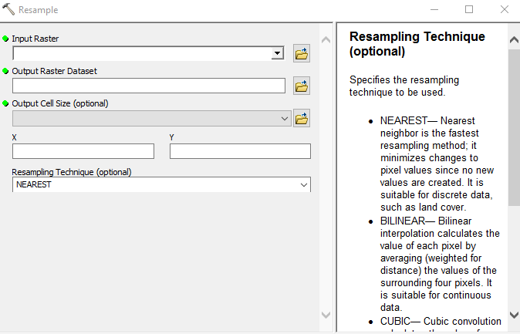
Conversion Between Data Models
Raster to Raster Conversion
To change cell sizes/resolutions: Tool Resample
From 10 m resolution…
Different choices for resampling the raster:
Nearest Neighbor → best for discrete data
Bilinear → best continuous data (elevation, slope, temperature, precip.)
Cubic Convolution
Majority
ArcMap Tool: Resample
Note: these are interpolation methods. We will talk about this next lecture!
…to 200 m
resolution
Notes:
What do you see here?

Slide 30
Conversion Between Data Models
Raster to Raster Conversion
To change cell sizes/resolutions
From 10 m resolution…
Can I convert elevation raster to polygon?
…to 200 m
resolution
Notes:
DISCUSS
No, because to convert raster to polygon the raster must contain integer value and elevation is not an integer value but float

Slide 31
Learning Objectives
1
2
3
Conversion between data models
Rasterization
Vectorization
Geometric operation
(vector)
Distance
Buffer
…
Attribute operations
(vector & raster)
Selection by attribute and location
Aggregation
Overlay
Today’s topics

Slide 32
Vector analysis: question?
Where is object A located? → coordinates
How are points and lines distributed in the space?
Where is object A in relation to another object B? → overlay, distance
How many A-objects are there near object B? → distance buffer
How many A-objects are there within an area determined by object B? → overlay, aggregation / sum
What is the shortest / fastest way between A and B? → network
What analysis that can be carried out depends on:
measurement level, data type and data structure, and software

Slide 33
Types of analysis / basic operations
Geometric operations
Distance
Buffers
Perimeter
Area
...

Slide 34
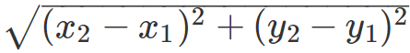
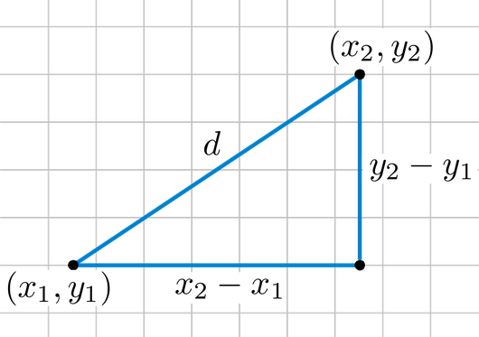
Geometric operations: Dimension
Distance
Euclidean Distance (most common distance)
Manhattan distance
Network distance (e.g. road, river length)
Surface distance (3D distance)
Cost distance
d =
The Euclidean distance between two points in either the plane or 3D space measures the length of a segment connecting the two points
Notes:
Euclidean distance need to have spatial units defined in meter or km for example.
The Euclidean distance between two points in either the plane or 3-dimensional space measures the length of a segment connecting the two points. It is the most obvious way of representing distance between two points.
The Pythagorean Theorem can be used to calculate the distance between two points, as shown in the figure below. If the points (x1,y1) and (x2,y2) are in 2-dimensional space, then the Euclidean distance between them is the formula.
With Euclidean distance, we only need the (x, y) coordinates of the two points to compute the distance with the Pythagoras formula.
Remember, Pythagoras theorem tells us that we can compute the length of the “diagonal side” of a right triangle (the hypotenuse) when we know the lengths of the horizontal and vertical sides, using the formula a² + b² =c².
A taxicab geometry or a Manhattan geometry is a geometry whose usual distance function or metric of Euclidean geometry is replaced by a new metric in which the distance between two points is the sum of the absolute differences of their Cartesian coordinates. The taxicab metric is also known as rectilinear distance, L1 distance, L1 distance or ℓ 1 \ell _{1} norm (see Lp space), snake distance, city block distance, Manhattan distance or Manhattan length.[1] The latter names refer to the rectilinear street layout on the island of Manhattan, where the shortest path a taxi travels between two points is the sum of the absolute values of distances that it travels on avenues and on streets.
In spatial analysis and geographic information systems, cost distance analysis or cost path analysis is a method for determining one or more optimal routes of travel through unconstrained (two-dimensional) space. The optimal solution is that which minimizes the total cost of the route, based on a field of cost density (cost per linear unit) that varies over space due to local factors.

Slide 35
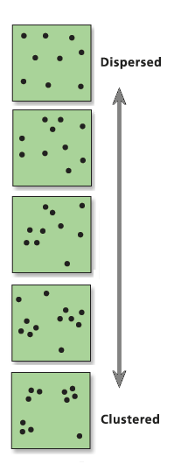
Geometric operations: Dimension
Distance
Euclidean Distance (most common distance)
Manhattan distance
Network distance (e.g. road, river length)
Surface distance (3D distance)
Cost distance
When do you use the Euclidean distance?
Example:
Understand the distribution of you data: dispersed or clustered?

Slide 36
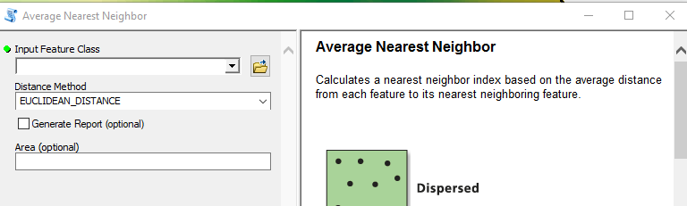
Geometric operations: Dimension
Distance
Euclidean Distance (most common distance)
Tool: Average Nearest Neighbor
The Average Nearest Neighbor tool measures the distance between each feature centroid and its nearest neighbor's centroid location. It then averages all these nearest neighbor distances. If the average distance is less than the average for a hypothetical random distribution, the distribution of the features being analyzed is considered clustered.

Slide 37
Geometric operations: Data distributions
How data (points) are distributed?
RANDOM
UNIFORM/DISPERSED
CLUSTERED
Any point is equally likely to occur at any location, and the position of any point is not affected by the position of any other point
Every point is as far from all of its neighbors as possible: “unlikely to be close”
Many points are concentrated close together, and there are large areas that contain very few, if any, points: “unlikely to be distant”
Notes:
Types of Distributions
Random: any point is equally likely to occur at any location, and the position of any point is not affected by the position of any other point.
Uniform: every point is as far from all of its neighbors as possible: “unlikely to be close”
Clustered: many points are concentrated close together, and there are large areas that contain very few, if any, points: “unlikely to be distant

Slide 38
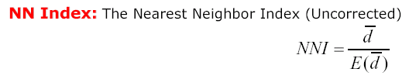
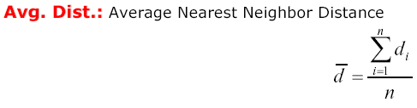
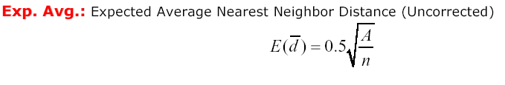
Geometric operations: Average nearest neigh. (NN) index
How do I know how my data is distributed?
Index:
where:
Interpretation of the index (average nearest neighbor ratio)
the index is less than 1 → the pattern exhibits clustering
the index is greater than 1 → the trend is toward dispersion
Notes:
Interpretation of the index
If the index (average nearest neighbor ratio) is less than 1, the pattern exhibits clustering. If the index is greater than 1, the trend is toward dispersion.

Slide 39
Geometric operations: NN index
RANDOM
UNIFORM
CLUSTERED
Mean distance
Mean distance
Mean distance
NNI
NNI
NNI
Notes:
Interpretation of the index
If the index (average nearest neighbor ratio) is less than 1, the pattern exhibits clustering. If the index is greater than 1, the trend is toward dispersion.

Slide 40
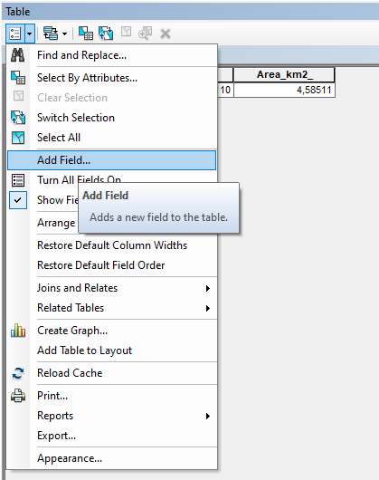
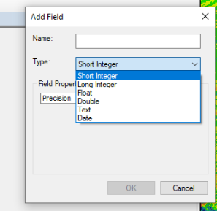
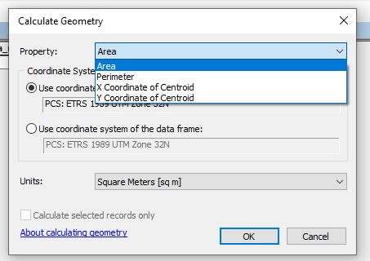
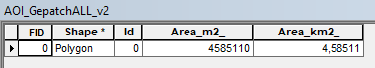
Geometric operations: Dimension
Distance
Euclidean Distance (most common distance)
Manhattan distance
Network distance (e.g. road, river length)
Surface distance (3D distance)
Cost distance
Area
Surface area
Perimeter
Create a new Field in Attribute Table

Slide 41
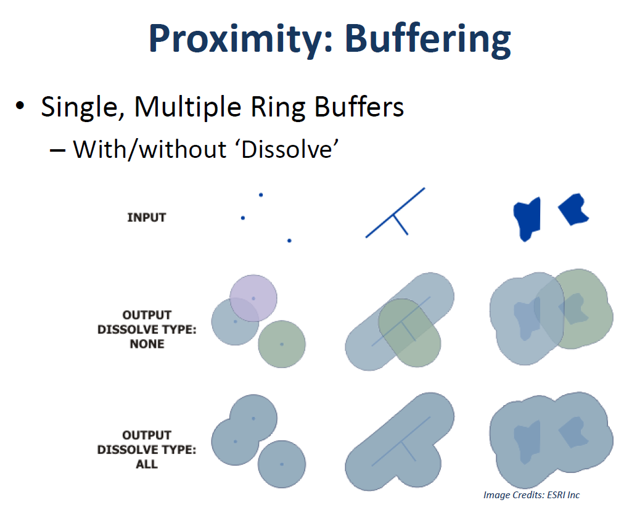
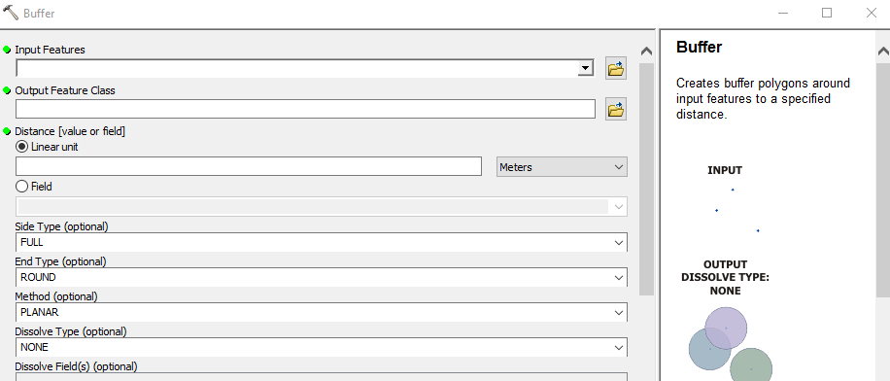
Geometric operations: Buffer
Single, Multiple ring buffers
POINT LINE POLYGON
Creates buffer polygons around input features to a specified distance
Tool: Buffer
Notes:
https://desktop.arcgis.com/en/arcmap/10.3/tools/analysis-toolbox/buffer.htm

Slide 42
Geometric operations: Buffer
Single, Multiple ring buffers
POINT LINE POLYGON
Creates buffer polygons around input features to a specified distance
without “Dissolve”
Buffers are rings drawn around features at a specified distance from the features

Slide 43
Geometric operations: Buffer
Single, Multiple ring buffers
POINT LINE POLYGON
Creates buffer polygons around input features to a specified distance
without “Dissolve”
with “Dissolve”
Notes:
DISCUSS: When would you want to create a buffer?

Slide 44
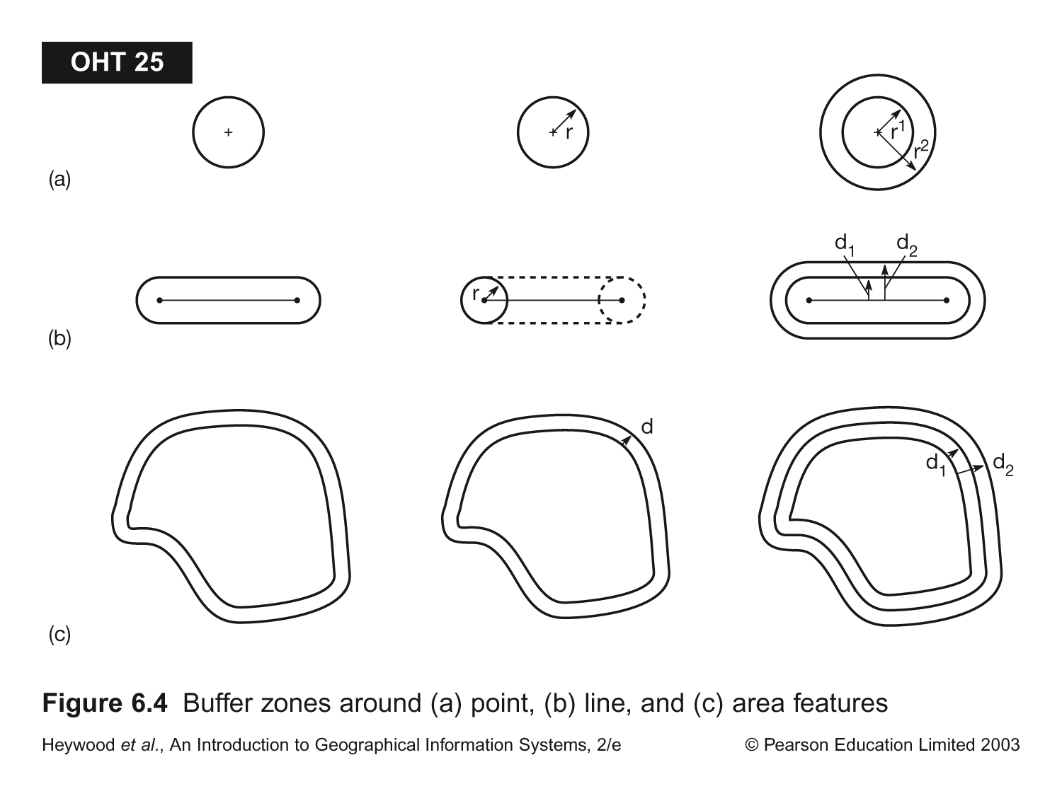
Geometric operations: Buffer
POINT
LINE
POLYGON
You define a buffer radius
You define a buffer distance
You define a buffer distance
Notes:
Buffer zone around a point line and area futures or polygon

Slide 45

Geometric operations: Buffer
Creates a zone (buffer) around an object:
Point buffer - a circle around the point
Line buffer - an elongated polygon around the line
Polygon buffer - a larger polygon around the polygon
You can change your buffer distance i.e. the radius of the buffer zone from the object
Inner buffer: gives an internal buffer zone
When we use it: Neighborhood analyses
What is within the buffers?
Spatial combination of attribute information based on location
Statistical operations (classification, regression, etc.)

Slide 46
Learning Objectives
1
2
3
Conversion between data models
Rasterization
Vectorization
Geometric operation
(vector)
Distance
Buffer
…
Attribute operations
(vector & raster)
Selection by attribute and location
Aggregation
Overlay
Today’s topics

Slide 47
Types of analysis
Attribute operations
Query / selection
based on attribute
based on location
Aggregation:
reclassification
removal of common boundaries
Overlay: union, clipping and intersect
Statistical operations (classification, regression, etc.)

Slide 48
Attribute operations: Queries, selection
An attribute query is the process of searching and retrieving records of features in a database based on desired attribute values
Do you know the SQL language
(SQL = Standard Query Language)
Notes:
An attribute query is the process of searching and retrieving records of features in a database based on desired attribute values.
Such queries are a fundamental part of managing and analyzing GIS data. Typically, this is performed using a criteria-based query language, most commonly SQL (SQL = Standard Query Language).
In most cases, the desired information can be given as a set of criteria based on the available attributes, such as "having a code of 'CURRENT'." These criteria are formatted in the appropriate query language as a Boolean expression, which can be validated as either true or false for each record in the database. Individual criteria can be constructed and combined using logical operators such as comparisons (>, <, =, >=, <=), Boolean algebra (and, or, not), and functions (sin, cos, sqrt, etc.).
An alternative to using attribute query is to perform a spatial selection.
Selection: ask for a selection from a dataset
ex. SELECT from dataset WHEN attribute> value

Slide 49
Attribute operations: Queries, selection
By Attribute values (Non-spatial query, SQL statement)
Single or multiple attribute questions (regardless of geography)
Data search and selection on the attribute Table
Boolean expression (and, or, not)
Statistical operations and function (sin, cos, sqrt, etc.)
Logical operators such as comparisons (>, <, =, >=, <=)
Notes:
An attribute query is the process of searching and retrieving records of features in a database based on desired attribute values.
Such queries are a fundamental part of managing and analyzing GIS data. Typically, this is performed using a criteria-based query language, most commonly SQL (SQL = Standard Query Language).
In most cases, the desired information can be given as a set of criteria based on the available attributes, such as "having a code of 'CURRENT'." These criteria are formatted in the appropriate query language as a Boolean expression, which can be validated as either true or false for each record in the database. Individual criteria can be constructed and combined using logical operators such as comparisons (>, <, =, >=, <=), Boolean algebra (and, or, not), and functions (sin, cos, sqrt, etc.).
An alternative to using attribute query is to perform a spatial selection.
Selection: ask for a selection from a dataset
ex. SELECT from dataset WHEN attribute> value

Slide 50
Attribute operations: Queries, selection
By Attribute values (Non-spatial query, SQL statement)
Single or multiple attribute questions (regardless of geography)
Data search and selection on the attribute Table
Boolean expression (and, or, not)
Statistical operations and function (sin, cos, sqrt, etc.)
Logical operators such as comparisons (>, <, =, >=, <=)
By Location (Spatial query or spatial selection)
Based on location information
Queries can be made interactively in GIS in single or multiple layers
Query builder - Click Based
Commands (e.g. SELECT, WHERE, AND, OR etc. ..)
Map-based (e.g. click in the map to see attributes)

Slide 51
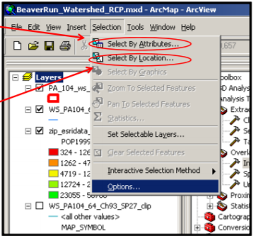
Attribute operations: Queries, selection
By Attribute values (Non-spatial query)
By Location (Spatial query)
Notes:
Querying the dataset databases can be done several different ways.
In ArcGIS, the 'Select by Attributes' window provides a quick way to build a SQL query to create a selection based on map attributes.
In the screenshot below, a simple SQL query has been built that queries the underlying 'POP' (population) attribute record of a layer containing information about US cities (citiesx020 in the example). After executing the query, only those cities having a population greater than 100000 will be selected in the map.

Slide 52
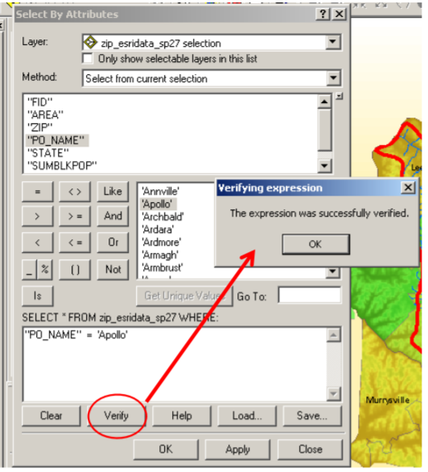
Attribute operations: Queries, selection
By Attribute values (Non-spatial query)
SQL = Standard Query Language
Build the SQL statement by simply clicking and double-clicking
“PO_NAME” = ‘Apollo’
Check your SQL statement with the “Verify ” button
Click “Apply”
Click “OK”
logical operator
Query expression
Notes:
Querying the dataset databases can be done several different ways, but they always use the same type of query language.
PO_NAME = Place Name
In the screenshot, a simple SQL query has been built that queries the underlying 'POP' (population) attribute record of a layer containing information about US cities (citiesx020 in the example). After executing the query, only those cities having a population greater than 100000 will be selected in the map.

Slide 53
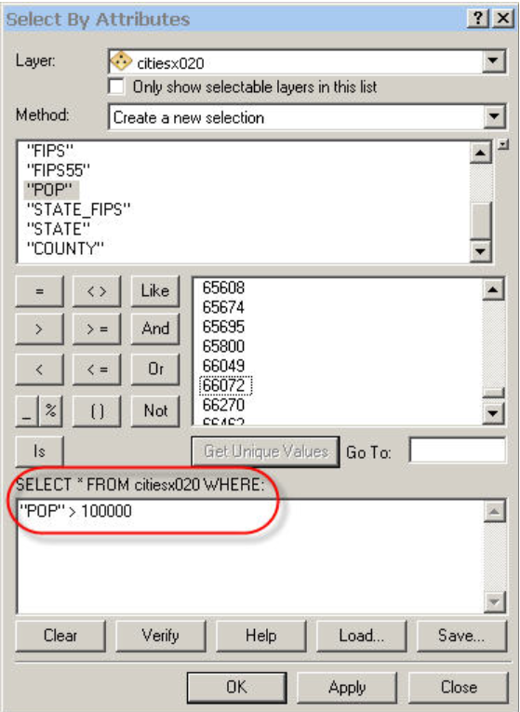
Attribute operations: Queries, selection
By Attribute values (Non-spatial query)
SQL = Standard Query Language
Build the SQL statement by simply clicking and double-clicking
“POP” > 100,000
logical operator
Query expression
Notes:
DISCUSS: What is being selected here?
Querying the dataset databases can be done several different ways, but they always use the same type of query language.
In the screenshot, a simple SQL query has been built that queries the underlying 'POP' (population) attribute record of a layer containing information about US cities (citiesx020 in the example). After executing the query, only those cities having a population greater than 100000 will be selected in the map.
http://wiki.gis.com/wiki/index.php/Attribute_Query_(Boolean_Selection)

Slide 54
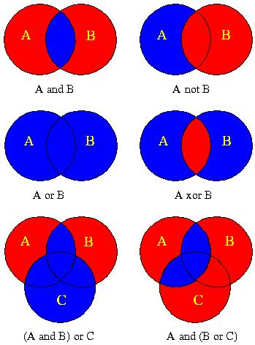
Attribute operations: Boolean queries
There are 4 basic statements used to get information from 2 (or more) datasets:
AND
OR
NOT
OR, BUT NOT BOTH (XOR)
?
?
?
?
What represent the blue area?
?
?
Notes:
DISCUSS
There are 4 basic statements used to get information from 2 (or more) datasets
AND – if you are desiring the subset of each dataset that is ‘true’ of both datasets
OR – if you are desiring the subset of each dataset that is ‘true’ of either one or both datasets
NOT – if you are desiring the subset of one dataset that is only true of one dataset
OR, BUT NOT BOTH (XOR) – if you are seeking the subset of data that is ‘true’ of one and another dataset, but not both datasets

Slide 55
Attribute operations: Boolean queries
There are 4 basic statements used to get information from 2 (or more) datasets:
AND – subset of each dataset that is ‘true’ of both datasets
OR – subset of each dataset that is ‘true’ of either one or both datasets
NOT – subset of one dataset that is only true of one dataset
OR, BUT NOT BOTH (XOR) – subset of data that is ‘true’ of one and another dataset, but not both datasets
Notes:
There are 4 basic statements used to get information from 2 (or more) datasets
AND – if you are desiring the subset of each dataset that is ‘true’ of both datasets
OR – if you are desiring the subset of each dataset that is ‘true’ of either one or both datasets
NOT – if you are desiring the subset of one dataset that is only true of one dataset
OR, BUT NOT BOTH (XOR) – if you are seeking the subset of data that is ‘true’ of one and another dataset, but not both datasets

Slide 56

Attribute operations: Boolean queries
Result Selection
The yellow polygons are the selected
Boolean query expression:
([Ftema] = 3311) and ([Area > 5,000,000])

Slide 57

Attribute operations: Arithmetical operations
A map of administrative units

Slide 58

Attribute operations: Arithmetical operations
A map of administrative units
Also contain population information for two or more years

Slide 59

Attribute operations: Arithmetical operations
This allow us to display the population as graded colors

Slide 60

Attribute operations: Arithmetical operations
Operation: calculate the change in population between 2000 and 1990
Query expression:
[pop2000] – [pop1990]
Output (new attribute): popdiff

Slide 61

Attribute operations: Arithmetical operations
Display this attribute in different ways:
Classes

Slide 62

Attribute operations: Arithmetical operations
Display this attribute in different ways:
2. Graduated colors
(percent of population of 1990)

Slide 63

Attribute operations: Arithmetical operations
Display this attribute in different ways:
3. Graduated symbols
(percent of population of 1990)

Slide 64


Attribute operations: Queries, selection
By Location (Spatial query)

Slide 65

Attribute operations: Queries, selection
By Location (Spatial query)
Intersect
within distance of
Completely contain
Are completely within
Have their center in
Touch the boundary of
Relationships between layers (that you can specify)
https://desktop.arcgis.com/en/arcmap/latest/map/working-with-layers/using-select-by-location.htm
Notes:
Relationships between layers (that you can specify)

Slide 66
Types of analysis
Attribute operations
Query / selection
based on attribute
based on location
Aggregation:
reclassification
removal of common boundaries
Overlay: union, clipping and intersect
Statistical operations (classification, regression, etc.)

Slide 67
Attribute operations: Aggregation
Grouping operation
Simplifies the dataset by merging identical objects
Connects adjacent polygons with similar properties (reclassification), and removes common boundaries
Vector:
Ex: Create new common attributes and remove old boundaries
Raster:
Ex: Give equal pixel values within each area that is aggregated

Slide 68

Attribute operations: Aggregation
Reclassification:
Merge pixel values (raster) or attributes (vector)
Can use boolean operations in the assignment
Example of raster reclassification using a Boolean operation

Slide 69

Attribute operations: Aggregation
Reclassification:
Merge pixel values (raster) or objects (vector)
Useful for creating new and simplified classes
Example of vector reclassification to simplify classes

Slide 70

Attribute operations: Aggregation
Dissolve operation:
The dissolve function aggregate neighboring polygons with the same attribute value (the borders between them are dissolved)
Change in geometry based on common attribute values
Example: simplifies datasets after a reclassification

Slide 71
Types of analysis
Attribute operations
Query / selection
based on attribute
based on location
Aggregation:
reclassification
removal of common boundaries
Overlay: union, clipping and intersect
Statistical operations (classification, regression, etc.)

Slide 72
Attribute operations: Overlay
Combine multiple layers of data into a new layer
Properties are passed on and a new topology is formed
Definition: Overlay is a GIS operation that superimposes multiple data sets (representing different themes) together for the purpose of identifying relationships between them.
Notes:
Overlay is a GIS operation that superimposes multiple data sets (representing different themes) together for the purpose of identifying relationships between them.^{[2]}. An overlay creates a composite map by combining the geometry and attributes of the input data sets. Tools are available in most GIS software for overlaying both Vector or raster data.
Overlay analysis is an age-old technique of deriving new information from two or more layers of data covering the same area. BEDROCK AND LANDUSE
For instance, if we have a layer of land use and a layer of soil fertility, we can derive from the two layers the percentage of agricultural land developed over fertile soil.
An overlay operation is much more than a simple merging of line work; all the attributes of the features taking part in the overlay are carried through.
Raster overlay involves two or more different sets of data that derive from a common grid. The separate sets of data are usually given numerical values. These values then are mathematically merged together to create a new set of values for a single output layer.
http://wiki.gis.com/wiki/index.php/Overlay

Slide 73

Attribute operations: Overlay
Combine multiple layers of data into a new layer
Properties are passed on and a new topology is formed
Raster
Vektor
Lag 1
Lag 2
Nytt lag
Notes:
Overlay is a GIS operation that superimposes multiple data sets (representing different themes) together for the purpose of identifying relationships between them.^{[2]}. An overlay creates a composite map by combining the geometry and attributes of the input data sets. Tools are available in most GIS software for overlaying both Vector or raster data.
Overlay analysis is an age-old technique of deriving new information from two or more layers of data covering the same area. For instance, if we have a layer of land use and a layer of soil fertility, we can derive from the two layers the percentage of agricultural land developed over fertile soil.
An overlay operation is much more than a simple merging of line work; all the attributes of the features taking part in the overlay are carried through.
Raster overlay involves two or more different sets of data that derive from a common grid. The separate sets of data are usually given numerical values. These values then are mathematically merged together to create a new set of values for a single output layer.
http://wiki.gis.com/wiki/index.php/Overlay

Slide 74
Attribute operations: Overlay
Combine different data layers to study contexts
Create new objects with multiple properties / attributes
Perform statistical analyses of combined layers
Create new delimitations for the objects
Examples:
Analyse connections between different layers
Suitability analysis of area for a given purpose
Mapping changes over different time (overlay maps from different times)
Notes:
Can you give some example:
Ex. is there a connection between bedrock and landslide?
Ex. which area is best suited for afforestation based on bedrock, loose materials and solar radiation?
Ex. how many new buildings have reached the country border since 1990?

Slide 75
Attribute operations: Overlay vector
To overlay, the input layers must:
have consistent topology
be in the same reference system
The new layer inherits and combines all topology from the input layers:
new and more complex topology
Intersection between all lines and polygon is calculated -> nodes
New polygons become new objects that must have unique ID number
The attribute tables can also be linked together
Complex and heavy calculation in relation to raster
Notes:
Overlay methods
In general, there are two methods for performing overlay analysis—feature overlay (overlaying points, lines, or polygons) and raster overlay. Some types of overlay analysis lend themselves to one or the other of these methods. Overlay analysis to find locations meeting certain criteria is often best done using raster overlay (although you can do it with feature data). Of course, this also depends on whether your data is already stored as features or rasters. It may be worthwhile to convert the data from one format to the other to perform the analysis.

Slide 76

Attribute operations: Overlay vector
Vector overlays: points-in-polygon
Notes:
One of the most basic questions asked of a GIS is "What's on top of what?" For example:
What land use is on top of what soil type?
What parcels are within the 100-year floodplain? ("Within" is just another way of saying "on top of.")
What roads are within what counties?
What wells are within abandoned military bases?
These types of questions are answered with the use of overlay tools.

Slide 77

Attribute operations: Overlay vector
Vector overlays: lines-in-polygon
NOTE: Overlay builds topology! Example: find lines in polygon (content)

Slide 78

Attribute operations: Overlay vector
Vector overlays: lines-in-polygon
Lines → logging roads
Polygons → vegetation types
Notes:
In the illustration below, logging roads (lines) and vegetation types (polygons) are overlaid to create a new line feature class. The lines have been split where they were intersected by polygons, and each line feature has been assigned the attributes of both original layers. The lines are shown symbolized by the vegetation type associated with each.

Slide 79

Attribute operations: Overlay vector
Vector overlays: polygon-on-polygon
Notes:
The Overlay toolset contains tools to overlay multiple feature classes to combine, erase, modify, or update spatial features, resulting in a new feature class. New information is created when overlaying one set of features with another. All of the overlay operations involve joining two sets of features into a single set of features to identify spatial relationships between the input features.

Slide 80





Attribute operations: Overlay vector
Vector overlays: polygon-on-polygon
https://desktop.arcgis.com/en/arcmap/10.3/tools/analysis-toolbox/an-overview-of-the-overlay-toolset.htm
Clipping
https://desktop.arcgis.com/en/arcmap/10.3/tools/analysis-toolbox/clip.htm
Notes:
Various GIS software packages offer a variety of polygon overlay tools, often with differing names. Of these, the following three are used most commonly for the widest variety of purposes:
Union, where the result includes all those polygon parts that occur in either A or B (or both), so is the sum of all the parts of both A and B. Different from identify in that individual layers are no longer identifiable. It is roughly analogous to OR in logic and addition in arithmetic.
Subtract, also known as Erase, where the result includes only those polygon parts that occur in one layer but not in another. It is roughly analogous to NOT in logic and subtraction in arithmetic.
Intersection, where the result includes all those polygon parts that occur in both input layers and all other parts are excluded. It is roughly analogous to AND in logic and multiplication in arithmetic.
The remainder are used less often, and in a narrower range of applications. If a tool is not available, all of these could be derived from the first three in two or three steps.
Used when we are only interested in data that is within a certain area (outline)
Clip contains the same overall extent as the intersection, but only retains the geometry and attributes of one of the input layers. It is most commonly used to trim one layer by a polygon represent an area of interest for the task. It can be derived as A subtract (A subtract B).
Symmetric Difference, also known as Exclusive Or, which includes polygons that occur in one of the layers but not both. It can be derived as either (A union B) subtract (A intersect B), or (A subtract B) union (B subtract A). It is roughly analogous to XOR in logic.
The outline that is cut forms new boundaries in the result
The outline can e.g. be a polygon in another data layer
Ex. property boundary, municipality, protected area, buffer zone

Slide 81
Attribute operations: Overlay vector
Overlay is a tool for analysis and presentation
Overlapped maps are a bad storage structure!
Visual and storage complexity
Many double stores of attributes
Difficult to make updates
Difficult to do other analyzes
Different analyzes -> different overlay strategies
A layered data structure provides the greatest flexibility!
Problem with spurious polygons

Slide 82
Attribute operations: Overlay vector
Overlay: Spurious polygons
Topological overlay may lead to the creation of spurious polygons because boundaries that are supposed to lie in the same place doesn’t
This can be due to:
Digitising errors
Scale effects (combining maps with different level of spatial generalisation)
Combining of data from different sources/users

Slide 83

Attribute operations: Overlay vector
Overlay: Spurious polygons
Generation of slivers polygons
=

Slide 84

Attribute operations: Overlay raster
To overlay, the input layers must:
Be in the same reference system
Have overlapping raster cells with equal resolution
possibly resampling to get the same raster resolution
Coherent pixels in each layer are combined using algebra (mathematical operations):
Addition, subtraction, multiplication, division, mean value, …
New raster pixel values should have a common measurement level and scale
Simple and fast calculation in relation to vector
Few analysis options!
Notes:
https://learngis.org/textbook/section-two-overlay-analysis
we looked at the rasters, stating they are a grid of cells, with each cell containing a unique value to represent the real world. For example, in classified rasters the values can represent the landscape, such as 3 for bare land and 5 for forested land and with Digital Elevation Models (DEM's), the values represent terrain values such as elevation, aspect, and slope.
Just like with vectors, we can perform overlay analysis with rasters using a different series of tools (as vector tools only work with vector layers, raster tools only works with raster layers, and with the exception of a vector layer designating an extent in some raster tools, there are no tools which combine vectors and rasters for geoprocessing). By “overlaying” one raster over another, we can examine the cell values from one raster to another and find relationships.
In order to compare rasters to complete Map Algebra, it is sometimes necessary to resample an image so the spatial resolution (the size of the pixel as compared to the real world) matches between the input layers. Resampling is done sometimes by taking the most common value, as in this example, or the average value within a group of pixels.
Raster datasets that will participate in a weighted overlay service have some special considerations. These considerations include raster format, pyramids and statistics, extent, bit depth, and handling of NoData or gaps.
In raster overlay, each cell of each layer references the same geographic location. That makes it well suited to combining characteristics for numerous layers into a single layer. Usually, numeric values are assigned to each characteristic, allowing you to mathematically combine the layers and assign a new value to each cell in the output layer.

Slide 85

Attribute operations: Overlay raster - add
Example of adding pixel values in a overlay raster
Lag 1
Lag 2
Nytt lag

Slide 86

Attribute operations: Overlay raster - add
Raster overlays: using addition
Use: find change in the landscape or change detection
Notes:
This approach is often used to rank attribute values by suitability or risk, then add them to produce an overall rank for each cell. The various layers can also be assigned a relative importance to create a weighted ranking (the ranks in each layer are multiplied by that layer's weight value before being summed with the other layers).
One example of Map Algebra is the ability to find change in the landscape or change detection. Since we know that all rasters are made up of a complete grid, we can overlay one with another, and compare the cells that line up. If we had classified an image of a forest from 1999 with a spatial resolution of 30 meters, assigning values of ‘5’ for forest and ‘3’ for bare land, then repeated the process for an image from 2015 (with the same spatial resolution, as that does make a difference when it comes to comparing raster images), we now have an input raster (1999) and a comparison raster (2015) to use in our map algebra tool. Applying map algebra to the input and comparison rasters will expose the cells which changed from bare land to forest.

Slide 87

Attribute operations: Overlay raster - add
Raster overlays: using addition
Forest change between 1999 and 2015
Forest in 1999
Forest in 2015
Notes:
One example of Map Algebra is the ability to find change in the landscape or change detection. Since we know that all rasters are made up of a complete grid, we can overlay one with another, and compare the cells that line up.
If we had classified an image of a forest from 1999 with a spatial resolution of 30 meters, assigning values of ‘5’ for forest and ‘3’ for bare land, then repeated the process for an image from 2015 (with the same spatial resolution, as that does make a difference when it comes to comparing raster images), we now have an input raster (1999) and a comparison raster (2015) to use in our map algebra tool. Applying map algebra to the input and comparison rasters will expose the cells which changed from bare land to forest.

Slide 88

Attribute operations: Overlay raster
Algebra:
Notes:
This approach is often used to rank attribute values by suitability or risk, then add them to produce an overall rank for each cell. The various layers can also be assigned a relative importance to create a weighted ranking (the ranks in each layer are multiplied by that layer's weight value before being summed with the other layers).

Slide 89
Types of analysis
Attribute operations
Query / selection
based on attribute
based on location
Aggregation:
reclassification
removal of common boundaries
Overlay: union, clipping and intersect
Statistical operations (classification, regression, etc.)
another lecture

Slide 90
Types of analysis / basic operations: summary
Geometric operations
Distance, perimeter, area, lines, directions, objects/points, etc.
Buffers
Attribute operations
Query / selection
Based on attribute and based on location
Aggregation: Reclassification and removal of common boundaries
Overlay: union, clipping and intersect
Statistical operations (classification, regression, etc.)
Network
another lecture

Slide 91
Types of analysis / basic operations: summary
Scripting
When a complex series of commands must be used frequently to retrieve and transform data (e.g. buffer, overlay, new attributes) it is sensible to create a structures command file
Multi-criteria analysis (MCA) is a technique used to consider many different criteria when making a decision.
another lecture

Slide 92

Analysis tool summary
Types of geoprocessing operations (Multiple Layer Operations):
Buffer
Dissolve
Append (spatial join)
Clip
Intersect
Union
Erase

Slide 93

Thanks!
Feedback questions

